Slide 1
Porshhair.com
Designed and Coded by Hiru Ranasinghe

Slide 2
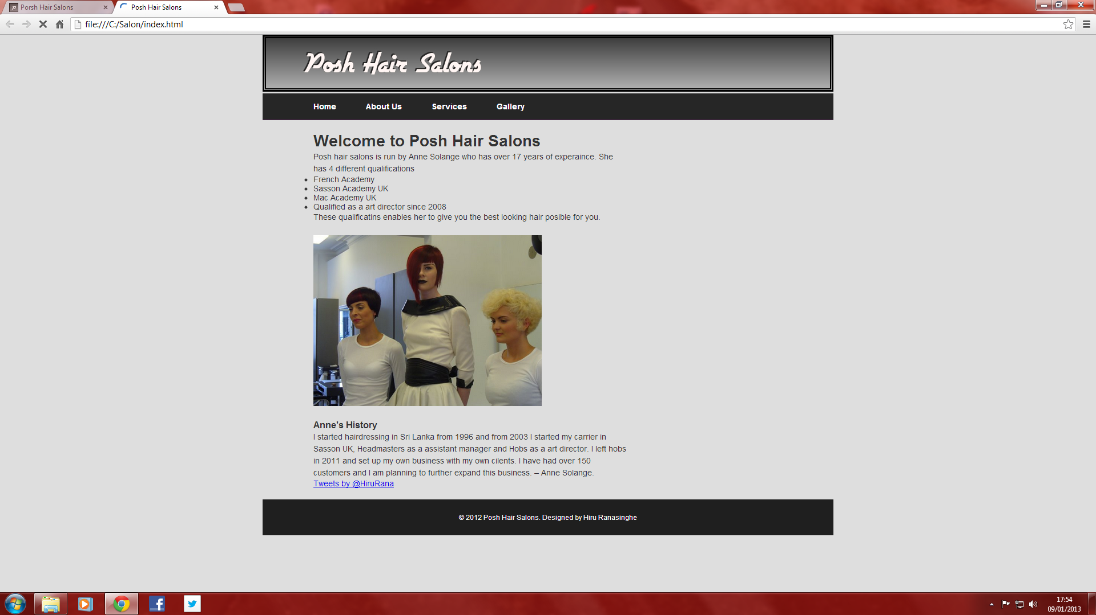
First design (when deployed)

Slide 3
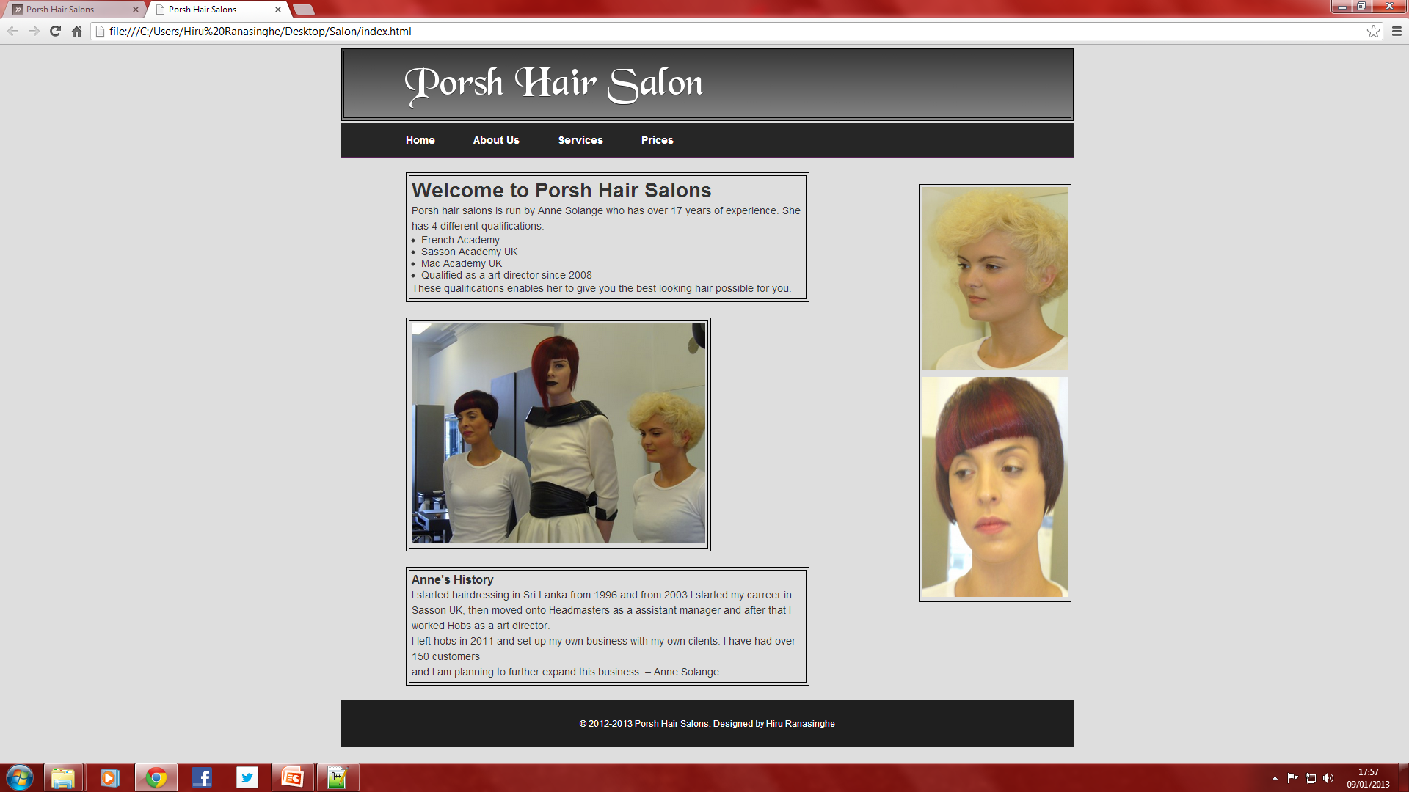
Second design

Slide 4
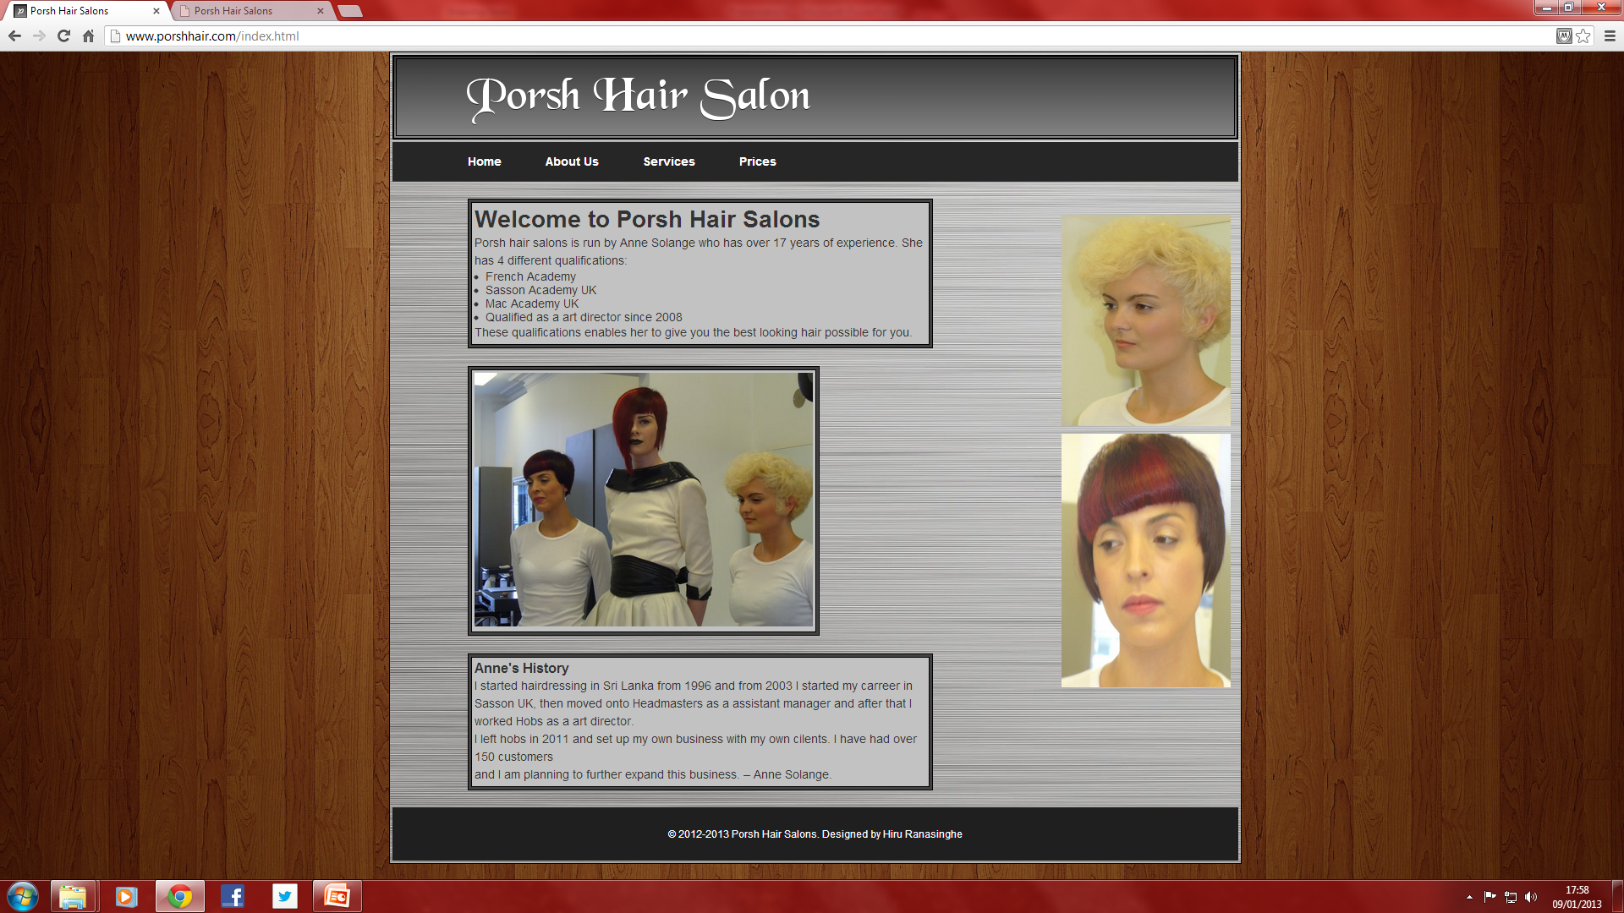
3rd Design (deployed)

Slide 5
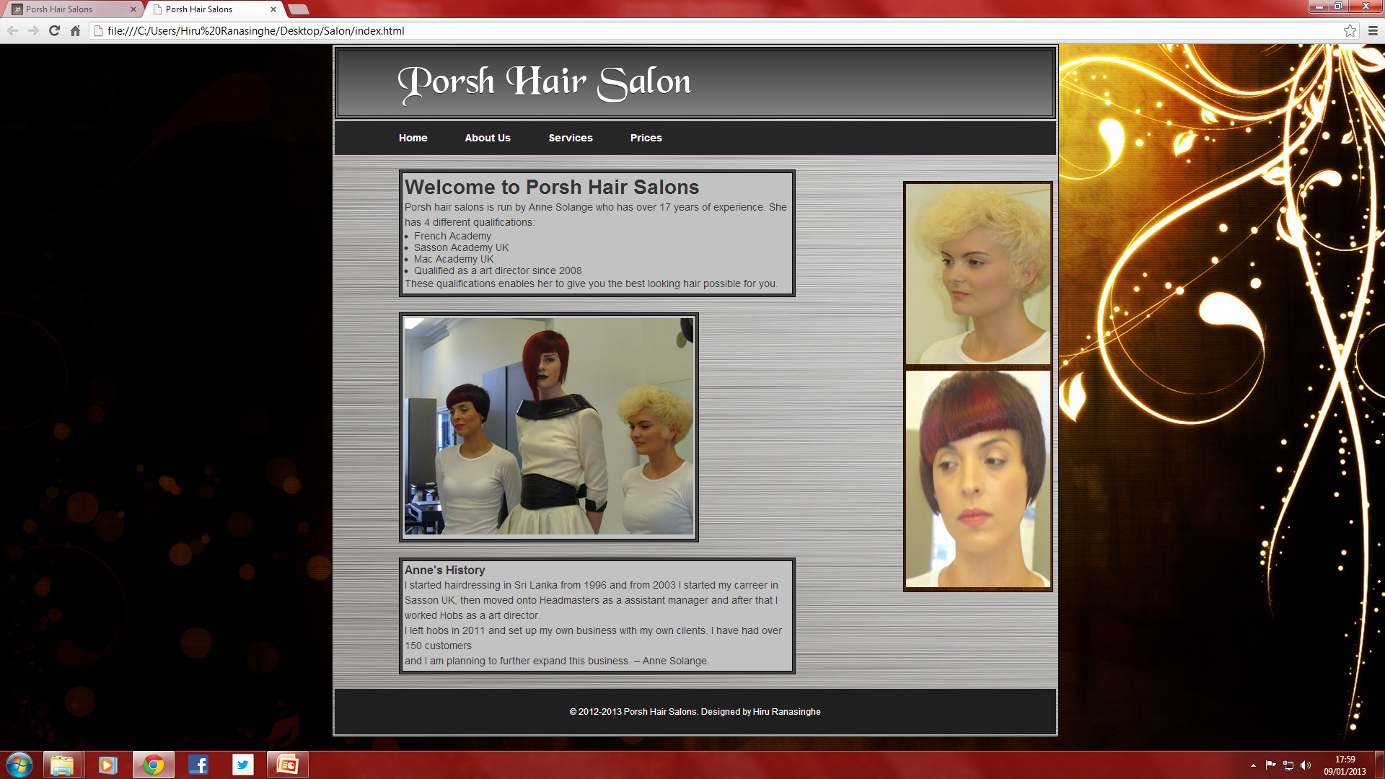
4th Design (Concept)

Slide 6
Features
Tap to call
Click to email
Google maps plug-in
Responsive web design

Slide 7
Future features
Online booking
Interacting website
More content
Twitter Plug-in
Facebook Plug-in

